Slide 1
Business Intelligence in Practice Create a data chart
Dr. Kate Han

Slide 2
Why data matters in BI?
Align your business to appropriate BI and analytical solutions.
By using a data understanding framework, you will know your data inventory
Understand data sources and uses and be better positioned for success.
Support decision making in business
Convert business to data-driven

Slide 3
How to use data for BI?
Prioritize BI/analytics efforts to meet business needs.
Reach consensus on business vocabulary and definitions.
Craft solutions that meet all customer needs and deliver value.
Manage costs and risks embedded in current reporting and BI approaches.
Partner to expedite “time-to-market” (learn and share).

Slide 4
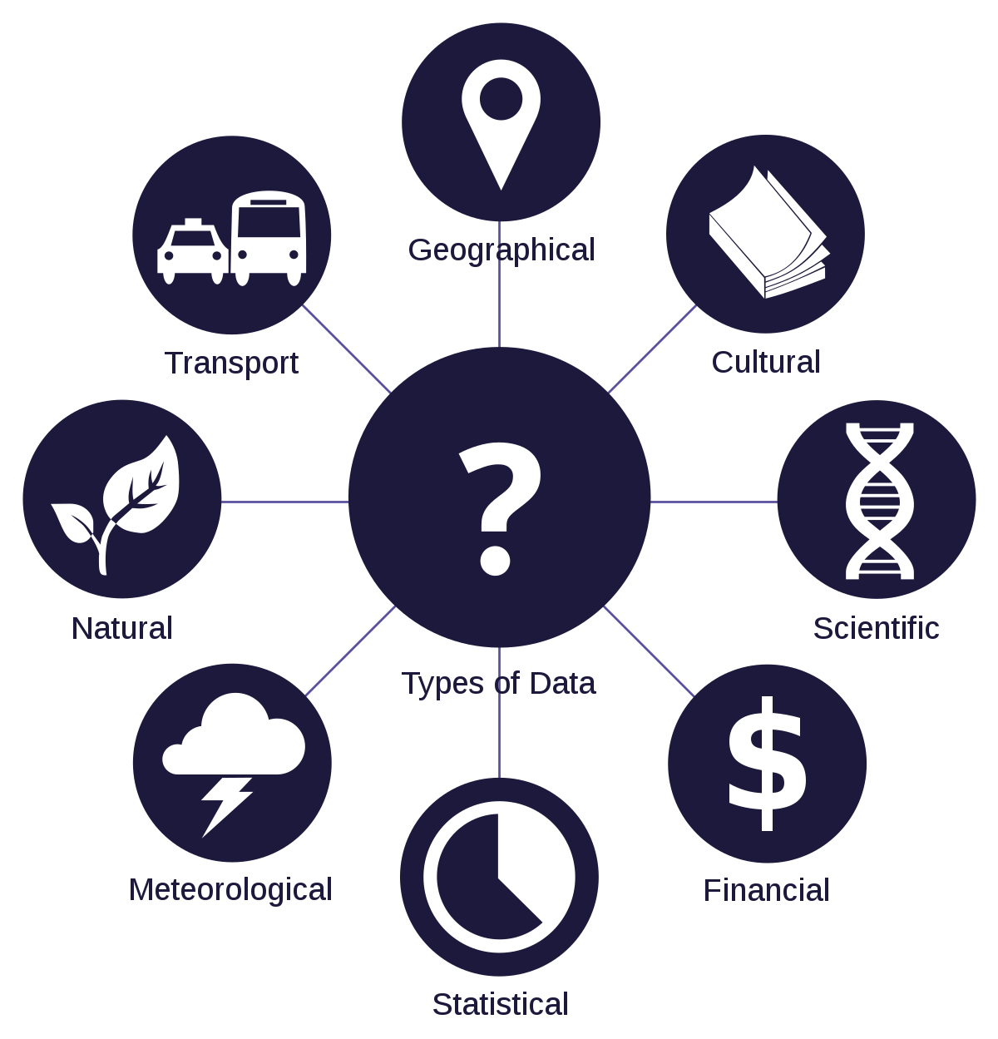
Understand your data
What is Data?
Data is a collection of facts, such as numbers, words, measurements, observations or just descriptions of things.
Discrete Data vs Continuous Data
Discrete Data can only take certain values.
Continuous Data can take any value (within a range)
Make your own Graphs
Explore the wonderful world of graphs.
Create your own, and see what different functions produce.
Get to understand what is really happening.

Slide 5
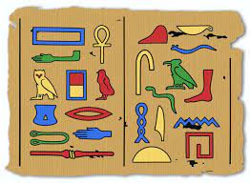
Origins of Data
Data dates back beyond the digital era
For example, ancient hieroglyphics from ancient Egypt represent data through pictures or symbols e.g., a bird represents the sound of the letter "a"

Slide 6
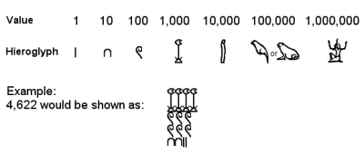
Origins of Data
Egyptians also used mathematics to solve various problems

Slide 7
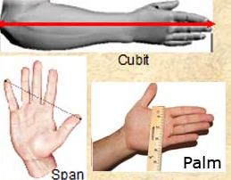
Origins of Data
Egyptian surveyors used body parts to measure land and buildings
E.g. a palm was the width of the hand, a cubit the measurement from elbow to fingertips

Slide 8
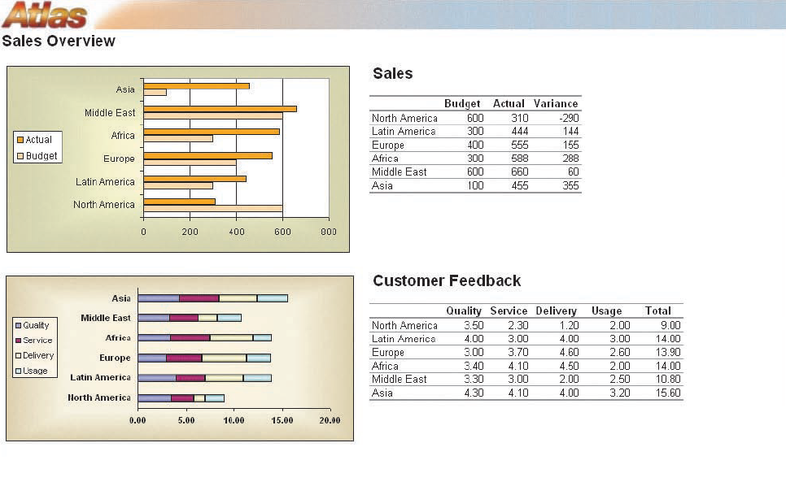
Business Data Example

Slide 9
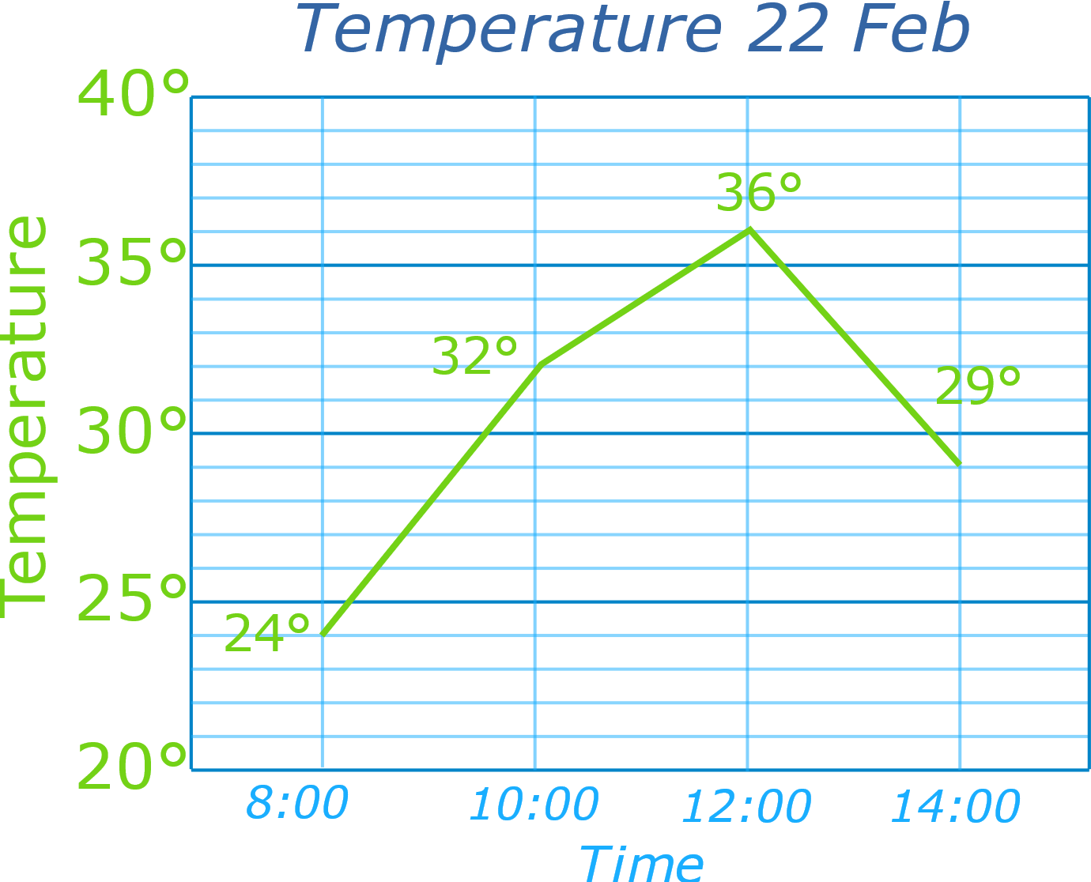
Line Graph: a graph that shows information connected in some way (usually as it changes over time).
You record the temperature outside your house and get these results:
You are interested to see how it rises and falls, so decide to make a line graph:
Table: Temperature 22 Feb
8:00 | 10:00 | 12:00 | 14:00
24° | 32° | 36° | 29°

Slide 10
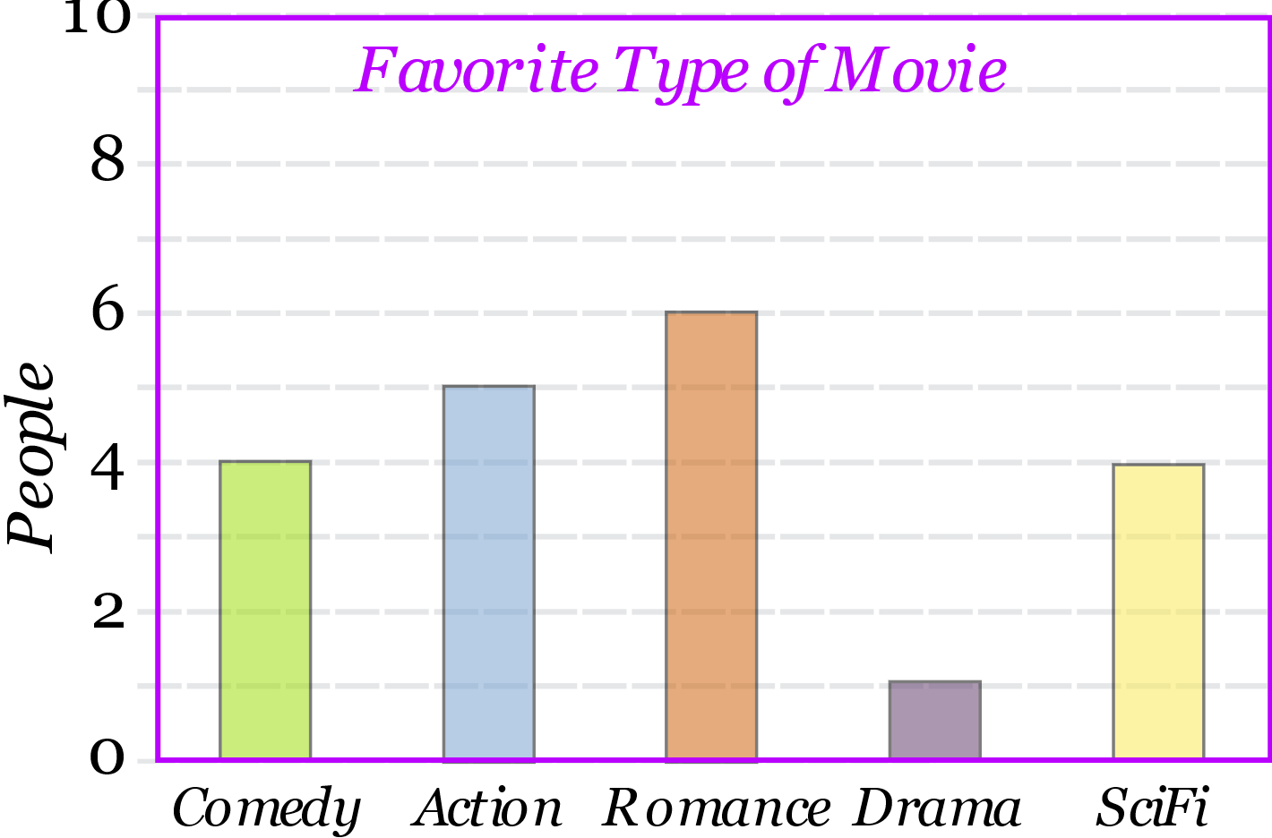
A Bar Graph (also called Bar Chart) is a graphical display of data using bars of different heights.
Imagine you just did a survey of your friends to find which kind of movie they liked best:
We can show that on a bar graph like this:
Table: Favourite Type of Movie
Comedy | Action | Romance | Drama | SciFi
4 | 5 | 6 | 1 | 4

Slide 11
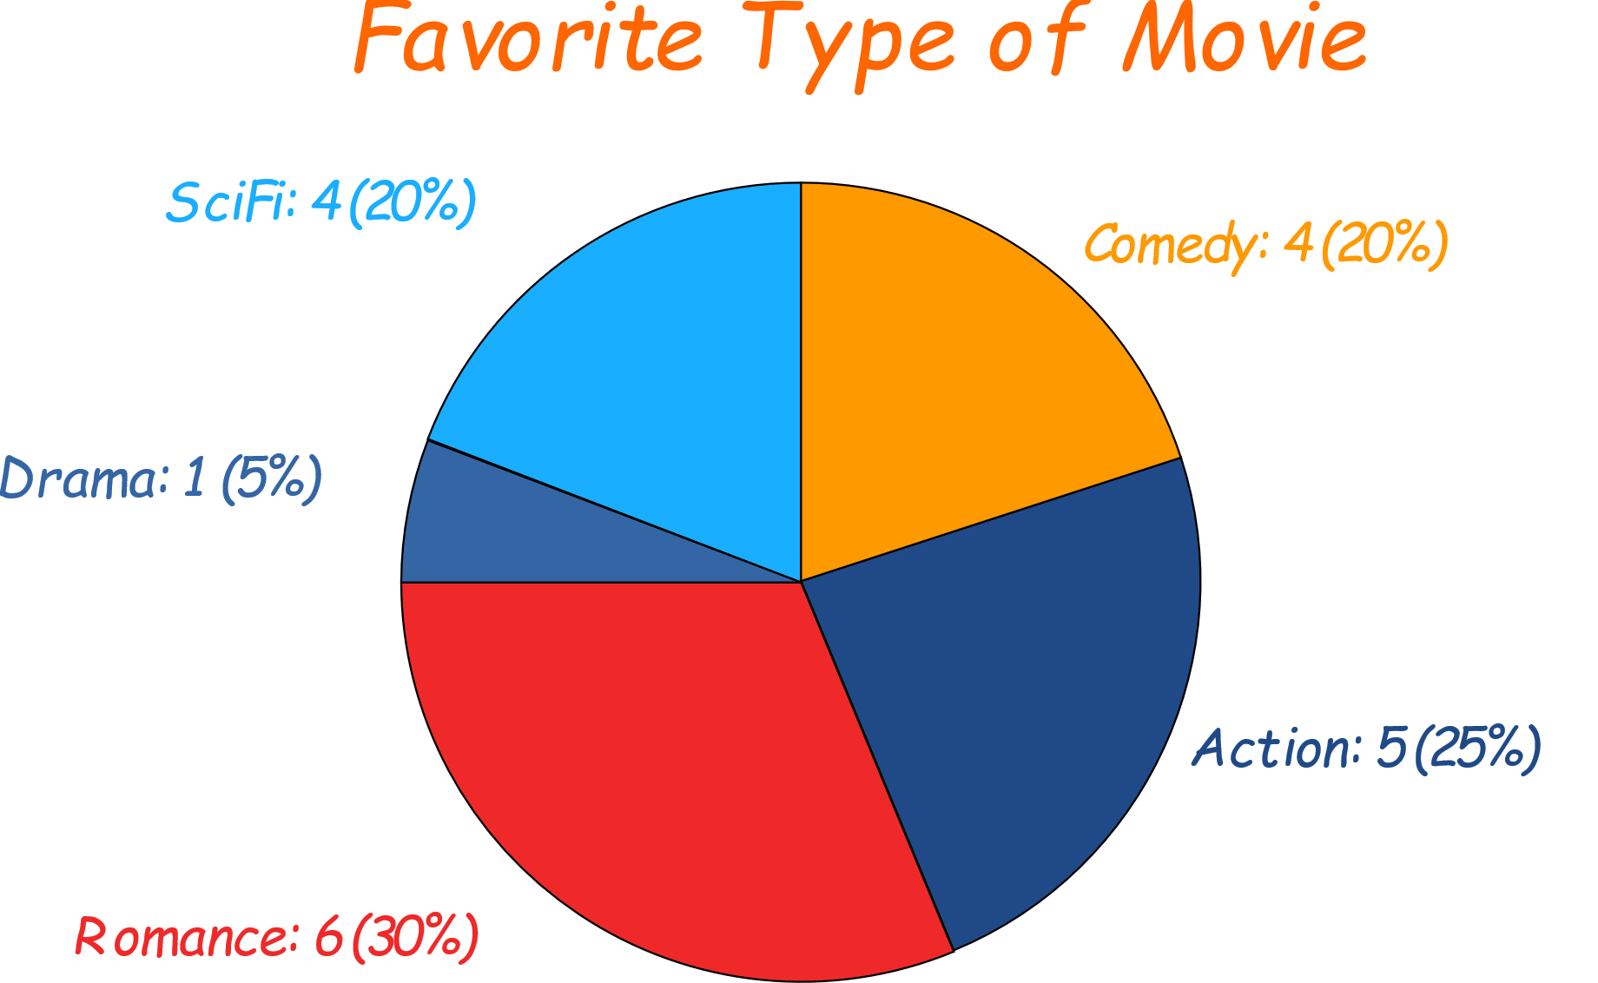
Pie Chart: a special chart that uses "pie slices" to show relative sizes of data.
Imagine you survey your friends to find the kind of movie they like best:
You can show the data by this Pie Chart:
Table: Favourite Type of Movie
Comedy | Action | Romance | Drama | SciFi
4 | 5 | 6 | 1 | 4

Slide 12
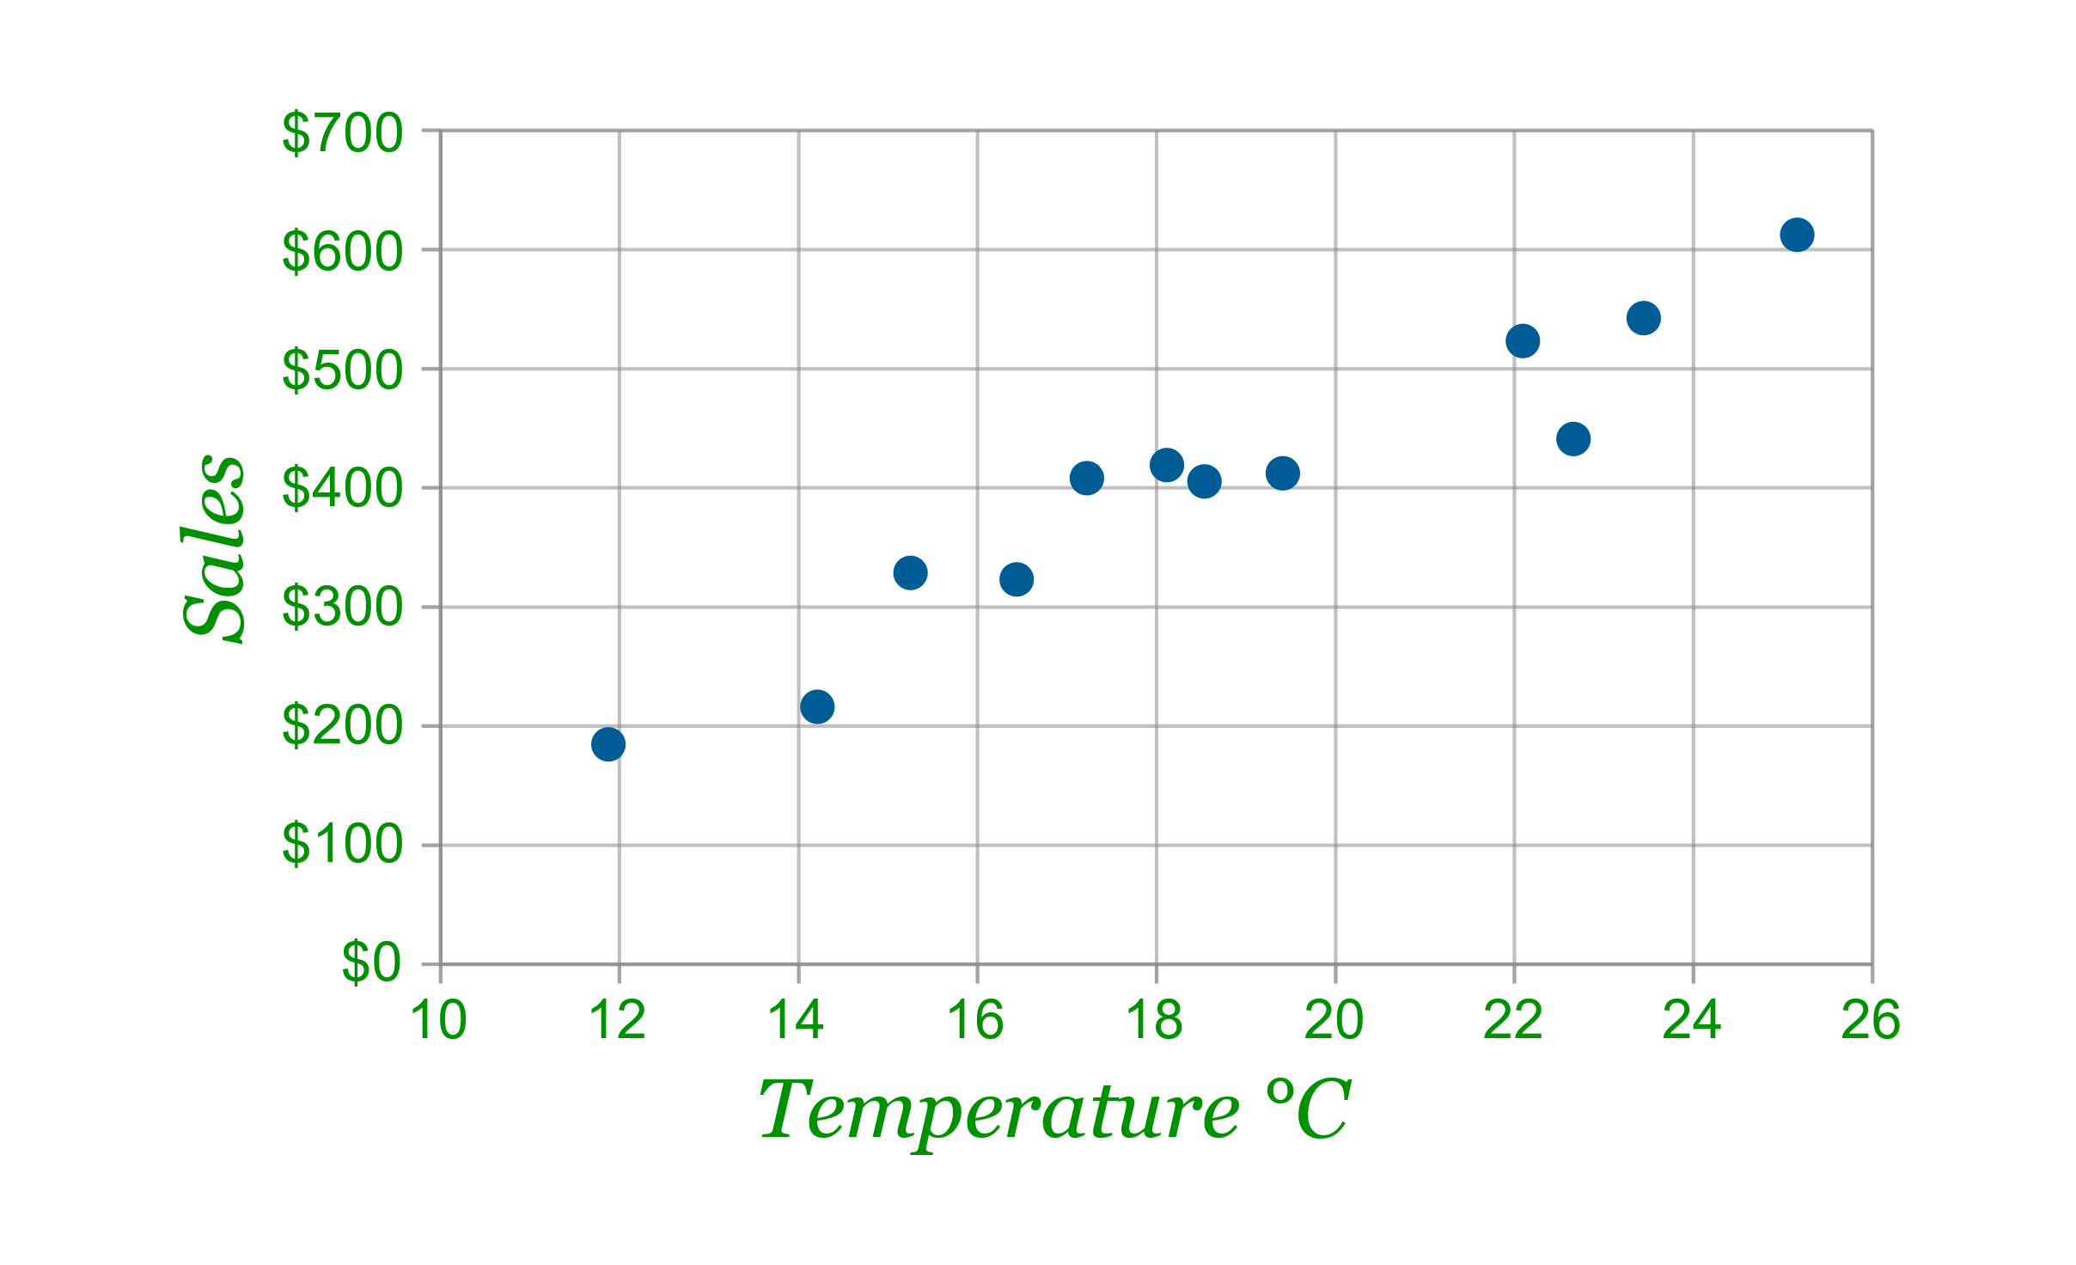
A Scatter (XY) Plot has points that show the relationship between two sets of data.
The local ice cream shop keeps track of how much ice cream they sell versus the noon temperature on that day. Here are their figures for the last 12 days:
And here is the same data as a Scatter Plot:
Ice Cream Sales vs Temperature
Temperature °C | Ice Cream Sales
14.2° | $215
16.4° | $325
11.9° | $185
15.2° | $332
18.5° | $406
22.1° | $522
19.4° | $412
25.1° | $614
23.4° | $544
18.1° | $421
22.6° | $445
17.2° | $408

Slide 13
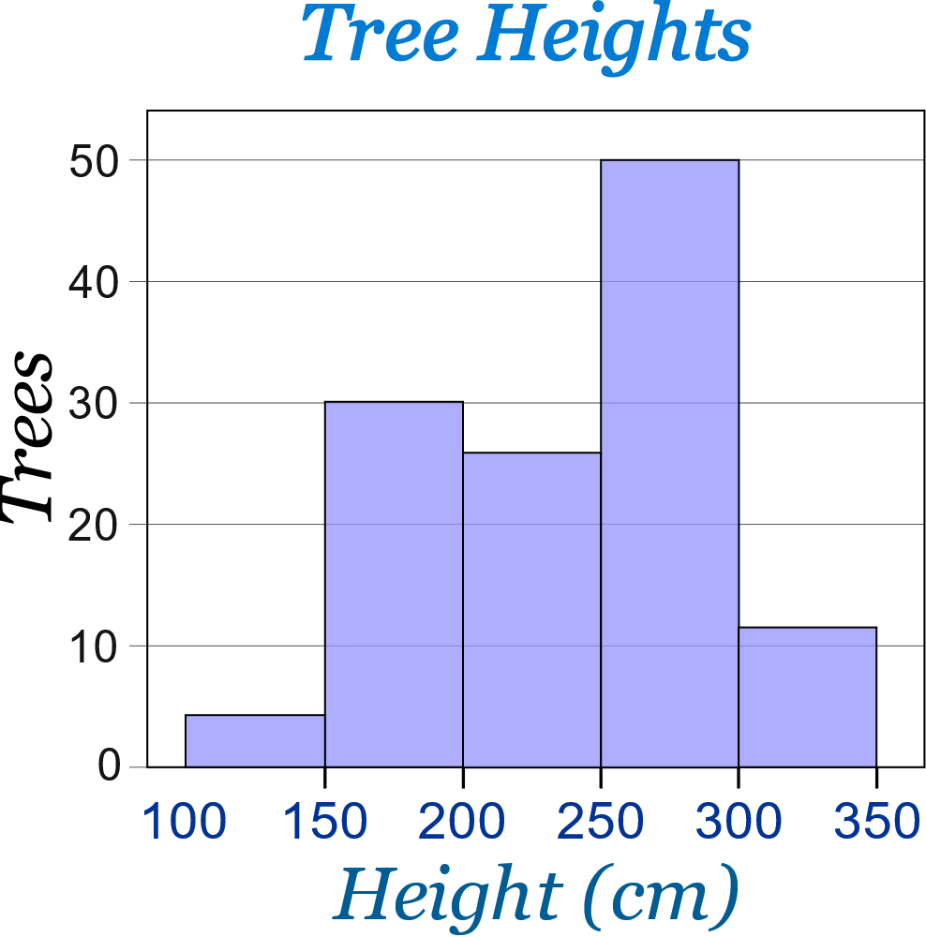

Histogram: a graphical display of data using bars of different heights.
Example: Height of Orange Trees
And here is the result:
You can see (for example) that there are 30 trees from 150 cm to just below 200 cm tall
You measure the height of every tree in the orchard in centimetres (cm)
The heights vary from 100 cm to 340 cm
You decide to put the results into groups of 50 cm:
The 100 to just below 150 cm range,
The 150 to just below 200 cm range,
etc...
So a tree that is 260 cm tall is added to the "250-300" range.

Slide 14
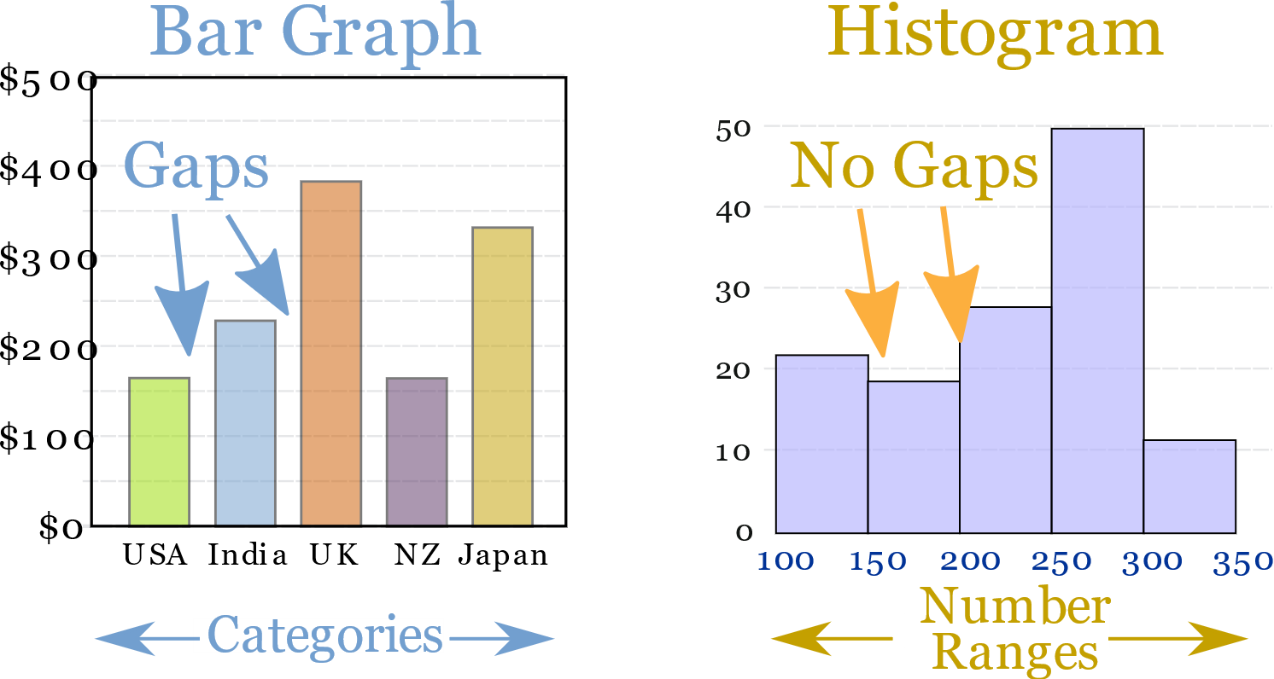
Bar vs Histogram
When the data is in categories we should use a Bar Chart.
Histograms are a great way to show results of continuous data, such as:
Country
Favourite Movie
etc.
weight
height
how much time
etc.

Slide 15
Thank you!

